Slide 1
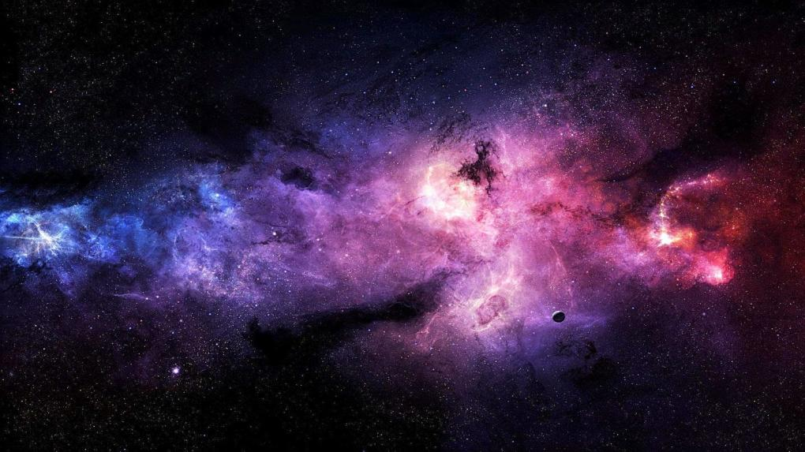
Design Spaceship
DESIGN SPACESHIP PROTOTYPE
By S2G5 Group
Presented by: TA201 S2G5 GROUP

Slide 2



ACKNOWLEDGEMENT
We would like to express our sincere gratitude to our tutor, Dr Alok Bhadauria, and our course instructor, Dr Sudhanshu Shekhar Singh, as well as the lab-in-charge, Mr. IP Singh, for their guidance and instruction in this project. Their support was instrumental throughout the execution of the project. We feel grateful to them for providing us with this opportunity to experience the lab component without any hiccups, through this online mode.
We also thank our TAs, Mr. Rajesh Behera and Mr. Prateek Kr Pradhan, for their valuable time and input.
In the end, we would like to express our heartfelt gratitude towards the entire TA201A course team for ensuring that we do not face any setback due to not having been to the lab and making it possible for us to dive a little deeper into the subject and get to explore our creativity along with it.

Slide 3
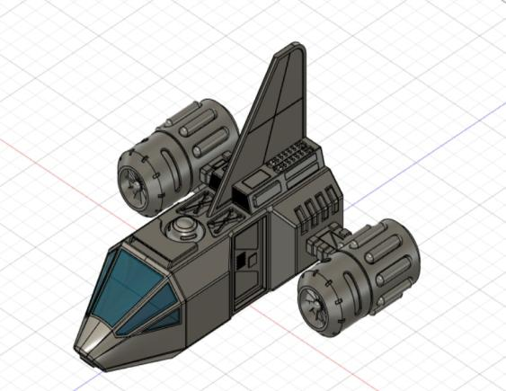
MOTIVATION
We came across this idea of a Design Spaceship, while trying to search for some innovative ideas for our TA201 project. We observed the model carefully and were extremely interested by the level of detailing which the original spaceship depicted. Thus, we decided to apply our knowledge of the subject in designing a model for the same.
We were intrigued by the capabilities of this masterpiece to survive in extreme conditions of outer space. We would be glad to work on an actual physical model, but in this online semester, our efforts are limited to a 3D model. We thus carry forward with this idea to explore the possibilities.

Slide 4
GROUP MEMBERS
Roll Number | Name
200929 | Arnav Shendurnikar
200861 | Sania Imteyaz
200864 | Sanidhya Singh
200869 | Sanjeev Kumar
200880 | Sarah Kapoor
200883 | Saren Ajmera
200909 | Sayan Deori
Instructor-in-charge: Dr Sudhanshu Shekhar Singh Tutor: Dr Alok Bhadauria Lab-in-charge: Mr. IP Singh

Slide 5
ROADMAP
Week 1 Discussion of ideas
Week 2 Finalization of project idea
Week 3
Isometric drawing of assembly, CAD model
Week 4 Isometric of parts, processes involved, CAD
Week 5
Final CAD models and PPT with all analysis

Slide 6
CONTRIBUTIONS
Turns | Sarah Kapoor 200880 | Arnav Shendurnikar 200929 | Sania Imteyaz 200861 | Sanidhya Singh 200864 | Saren Ajmera 200883 | Sayan Deori 200909
1 & 2 | Idea Discussion, Reviewed past projects | Idea Discussion, Reviewed past projects | Reviewed past projects | Idea Discussion | Reviewed past projects | Idea Discussion
3 | Isometric, PPT | Isometric | Manufacturing processes, list of parts | Manufacturing processes, list of parts | Manufacturing processes, list of parts | Manufacturing processes, list of parts, PPT
4 | Isometric and Orthographic, PPT | Isometric and Orthographic, PPT | Isometric and Orthographic Drawing | Detailed Dimensioning | Isometric and Orthographic Drawing | Isometric and Orthographic Drawing
5 | Presentation, CAD Models | CAD models, Animations | Cost Analysis | Detailed dimensioning of all parts and main model | Cost Analysis | Sustainability Analysis

Slide 7
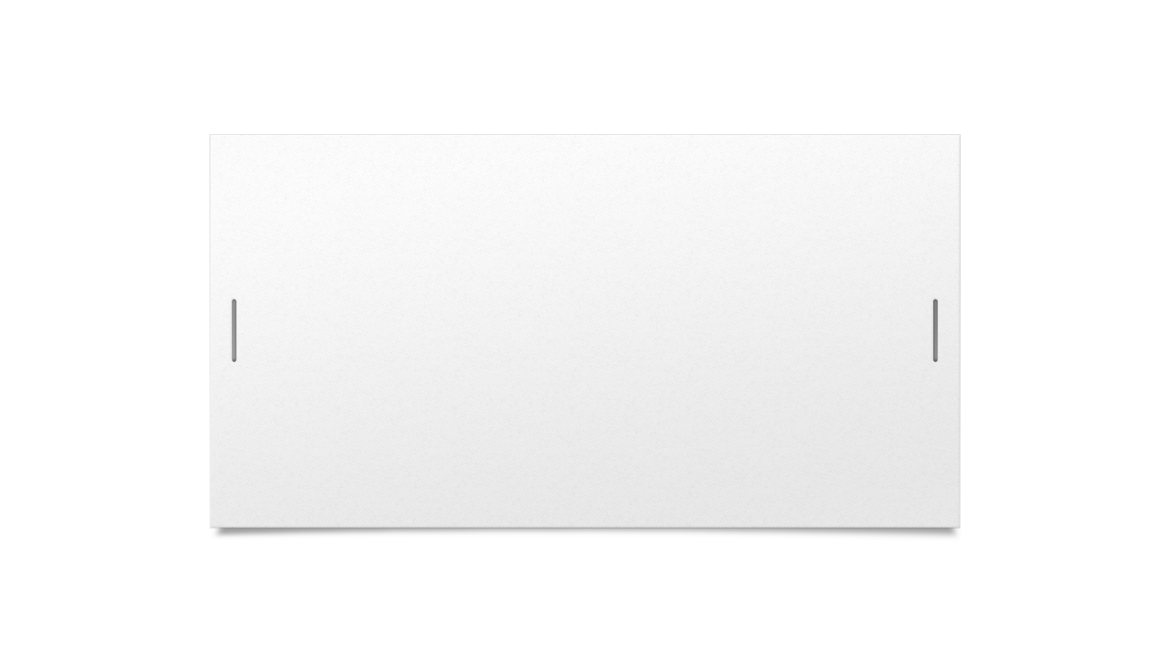
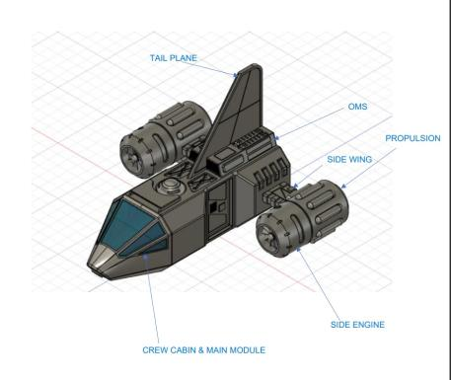

FINAL MODEL
1 | Main Module and Cockpit
2 | Side Engine
3 | Propulsion
4 | Side Wing
5 | Tail Plane
6 | Orbital Maneuvering System

Slide 8
WHAT IS A SPACESHIP?
A spacecraft is a vehicle or machine designed to fly in outer space. A type of artificial satellite, spacecrafts are used for a variety of purposes, including communications, Earth observation, meteorology, navigation, space colonization, planetary exploration, and transportation of humans and cargo.
The design of spacecraft covers a broad area, including the design of both robotic spacecraft (satellites and planetary probes), and spacecraft for human spaceflight (spaceships and space stations).

Slide 9
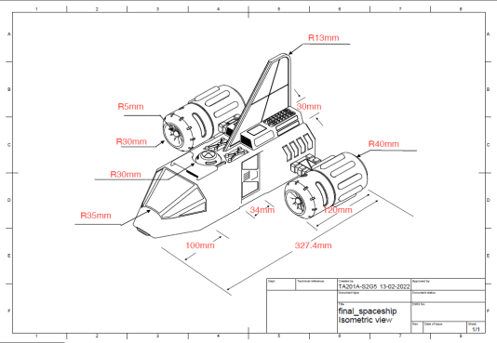
ISOMETRIC VIEW OF SPACESHIP

Slide 10
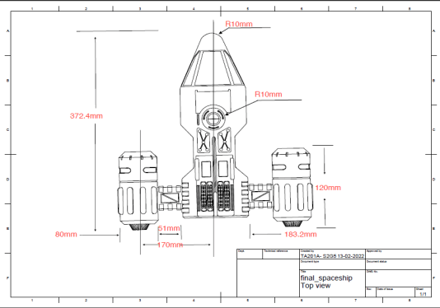
TOP VIEW OF SPACESHIP

Slide 11
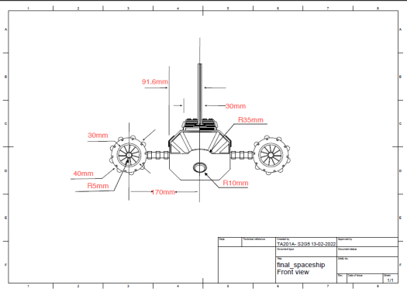
FRONT VIEW OF SPACESHIP

Slide 12
01
02
03
04
05
06
BRIEF OVERVIEW OF PARTS
MAIN MODULE & COCKPIT
SIDE ENGINES
PROPULSION
Capsule containing spacecraft system operations, and the front part of spaceship.
It gives thrust to the spaceship.
Gives speed and power to the side engine.
ORBITAL MANEUVERING SYSTEM
SIDE WINGS
TAIL PLANE
Wings that create lift. It provides hypersonic speed as well.
Provides stability and control.
Provides the thrust for orbit insertion, orbit circularization, etc.

Slide 13
MATERIALS USED
S. No. | Part Name | Material Used | Manufacturing Process
1. | Main Module and Cockpit | High grade Aluminium, Carbon fibers/composites, Glass, Mirror | Cutting, Welding, Surface Finishing
2. | Side Engine | Aluminium, Steel | Casting, Flank Milling, Point Milling, Integral Shroud Milling, End Milling
3. | Propulsion | Aluminium, Steel | Cutting , Metal Bending, Welding/Metal joining
4. | Side Wing | High grade Aluminium, Carbon fibers/composites | Cutting, Welding, Surface Finishing, Drilling
5. | Tail Plane | High grade Aluminium | Cutting, Surface Finishing
6. | Orbital Maneuvering System | High grade Aluminium, Carbon fibers/composites | Cutting, Welding, Surface Finishing

Slide 14
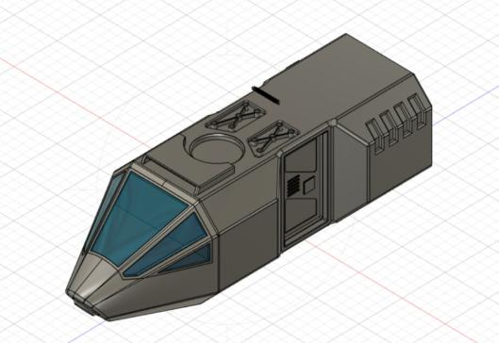
MAIN
MODULE
AND
COCKPIT

Slide 15
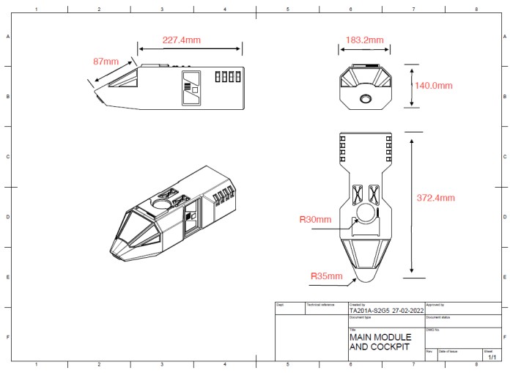
ISOMETRIC & ENGINEERING DRAWING

Slide 16
MAIN MODULE AND COCKPIT
About
A service module is a component of a crewed space capsule containing a variety of support systems used for spacecraft operations. The crew cabin consists of the flight deck, the mid-deck, and the utility area. The Flight Deck carries the commander and pilot. The mid deck has seats for crew members to rest. The utility area contains the water tanks and air.
Processes involved
Cutting
Welding
Surface Finishing
Materials required
High-grade Aluminium
Carbon fibre/carbon composite Glass Mirror

Slide 17
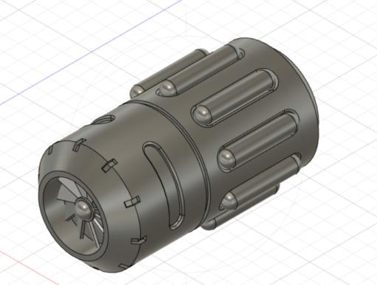
SIDE
ENGINE

Slide 18
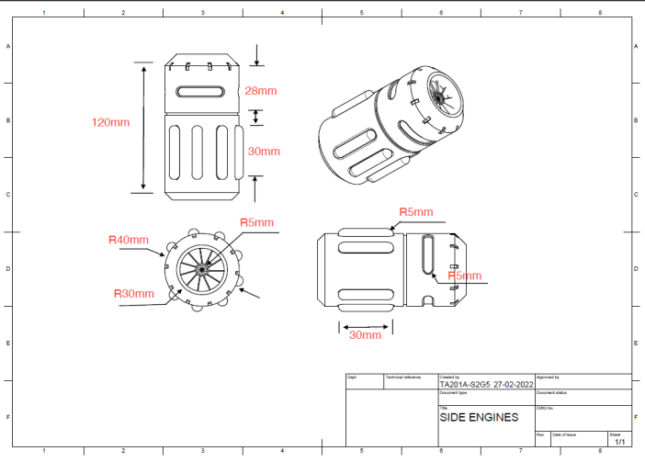
ISOMETRIC & ENGINEERING DRAWING

Slide 19
SIDE ENGINE
About
It is a device in which energy is transferred continuously through flowing fluid by the dynamic action of one or more moving blade rows. The impellers of side engines deliver the required propellant flow and pressure to the thrust chamber of rocket engines which help the spacecraft to maintain the required thrust throughout its motion. They are designed as radial flow components.
Processes involved
Casting
Flank Milling
Point Milling
Integral Shroud Milling
End Milling
Materials required
Aluminium
Steel

Slide 20
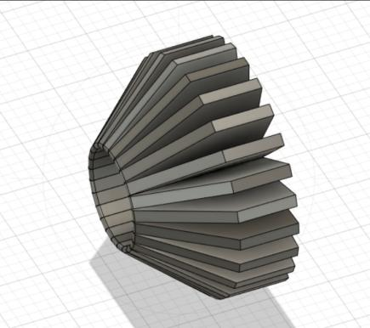
PROPULSION

Slide 21
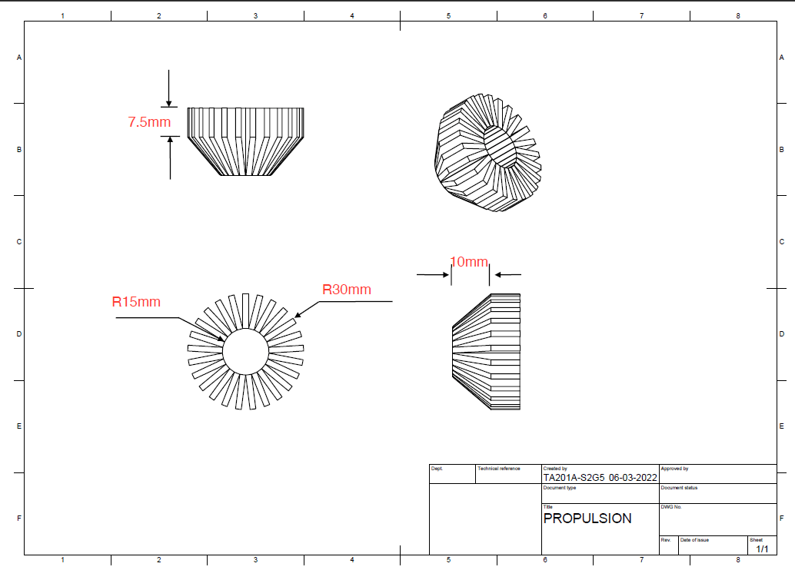
ISOMETRIC & ENGINEERING DRAWING

Slide 22
PROPULSION
About
It is a device which provides power and speed to the side engine. It can also be thought of as the support of the side engine. The impellers of side engines deliver the required propellant flow and pressure to the thrust chamber of rocket engines which help the spacecraft to maintain the required thrust throughout its motion.
Processes involved
Cutting
Metal Bending
Welding/Metal joining
Materials required
Aluminium
Steel

Slide 23
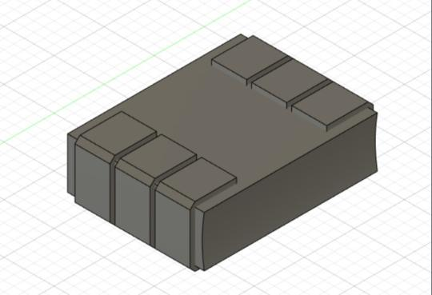
SIDE WING

Slide 24
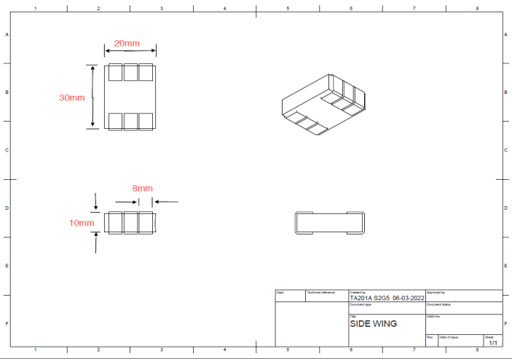
ISOMETRIC & ENGINEERING DRAWING

Slide 25
SIDE WINGS
About
The spaceship has wings that create lift. It provides hypersonic speed as well as provides a good lift -to-drag ratio during landing. Their leading part is well equipped with heat controlling material.
Processes involved
Cutting
Welding
Surface Finishing Drilling
Materials required
High-grade aluminium Carbon-Carbon Composites

Slide 26
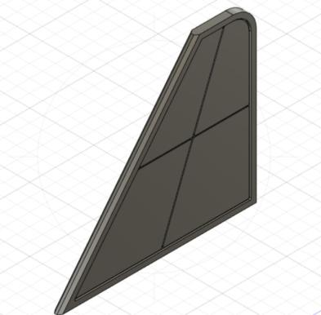
TAIL PLANE

Slide 27
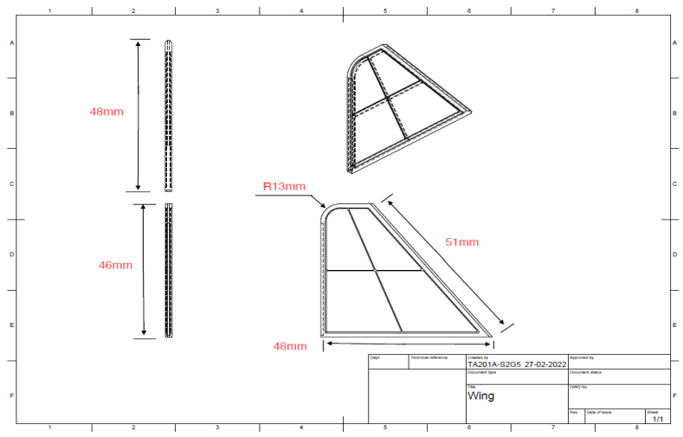
ISOMETRIC & ENGINEERING DRAWING

Slide 28
TAIL PLANE
About
A tailplane, also known as a horizontal stabiliser, is a small lifting surface located on the tail (empennage) behind the main lifting surfaces of a spaceship. The function of the tailplane is to provide stability and control.
Processes involved
Cutting
Surface Finishing
Materials required
High-grade aluminum (for strength and durability)

Slide 29
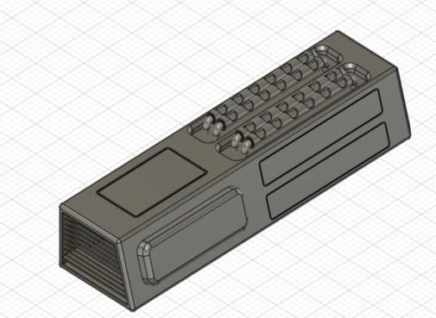
ORBITAL
MANEUVERING
SYSTEM

Slide 30
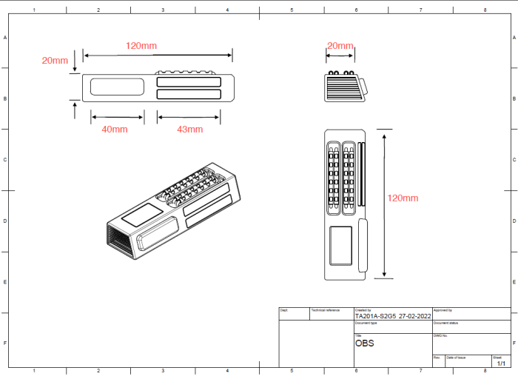
ISOMETRIC & ENGINEERING DRAWING

Slide 31
ORBITAL MANEUVERING SYSTEM
About
The orbital maneuvering system provides the thrust for orbit insertion, orbit circularization, orbit transfer, rendezvous, deorbit, abort to orbit and abort once around.
Processes involved
Cutting
Welding
Surface Finishing
Materials required
Aluminium Carbon fibre/carbon composite (These materials are used because of their lightness and strength)

Slide 32
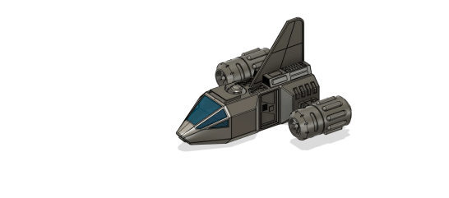
MODEL ANIMATION

Slide 33
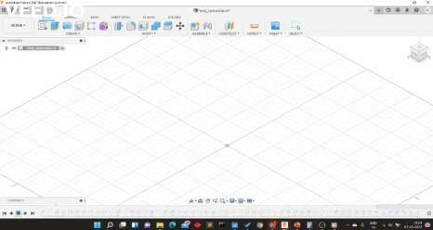
START-TO-FINISH ANIMATION

Slide 34
COST ANALYSIS
S. No | Material Used | Quantity | Rate | Cost (in Rupees)
1 | Aluminium | 703.648 cc | 190 Rs/kg | Rs 345.83
2 | Carbon fibre/ Carbon Composite | 90.8 cc | 1612.5 Rs/kg | Rs 234.26
3 | Steel | 27.12 cc | 53 Rs/kg | Rs 11.28
4 | Glass | 12mm thickness sheet, 36.92 square centimeter area | 0.16 Rs/Sq. cm | Rs 5.96
5 | Mirror | 40.2 square cm | 0.096 Rs/Sq, cm | Rs 3.85
Total Cost of Model, in Rupees |  |  |  | Rs 601.18

Slide 35
SUSTAINABILITY ANALYSIS
Known as the green metal, aluminium is one of the most environmentally friendly metals because of its sustainability. As the most recyclable industrial material, aluminium can be recycled infinitely to produce the same product. Recycling aluminium also saves 95% of the energy used in its production from raw materials.
Steel is very sustainable because once it is made, it can be used forever. Steel can be recycled an infinite number of times and be used with NO downgrading in quality.The non-renewable resources used to make steel, like minerals and fossil fuels, are not wasted because the steel will be used forever.
We also minimized the usage of plastic which is considered as a hazardous material. This is the way we are doing sustainable development.

